Slide 1

ue js
The progressive javascript framework

Slide 2
Why Vue js and key features
I’ts really fun to develop in vue
It’s fast
Flat learning curve
It’s really popular: 151k + stars in github vs 138k of react
It’s fast
It’s small, only 20Kb for a production build
Amazing tools, such as the cli and a UI utility to manage and create projects
It harvests the power of pure HTML, CSS and Javascript alike, no limitations

Slide 3
Why Vue js and key features
It only re-renders what it needs, even if it’s a deeply nested object or deeply nested component tree
Every component as access to the the main vue instance, making it useful to register global components, variables, mixins, prototypes and others to reduce boilerplate.
Smart features such as prefetch, memoizing

Slide 4
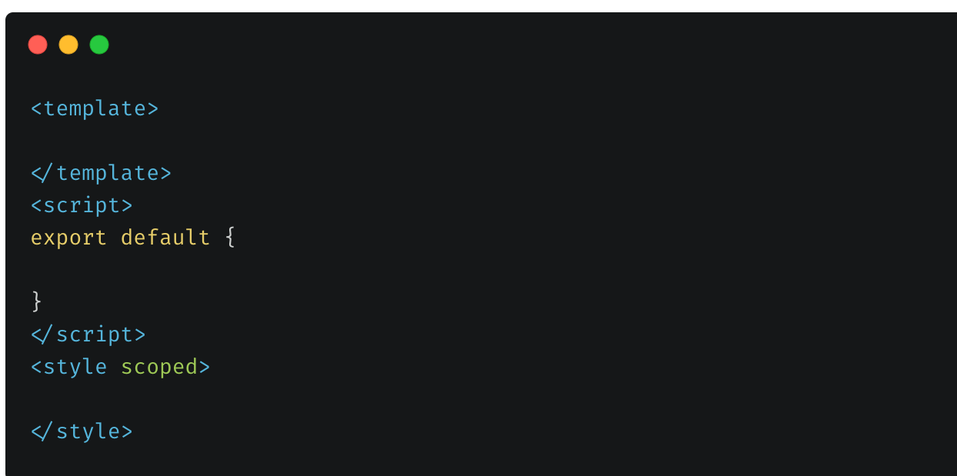
Single File components - How code is organized
HTML goes here
Your code goes here
Your styles, scope is optional

Slide 5
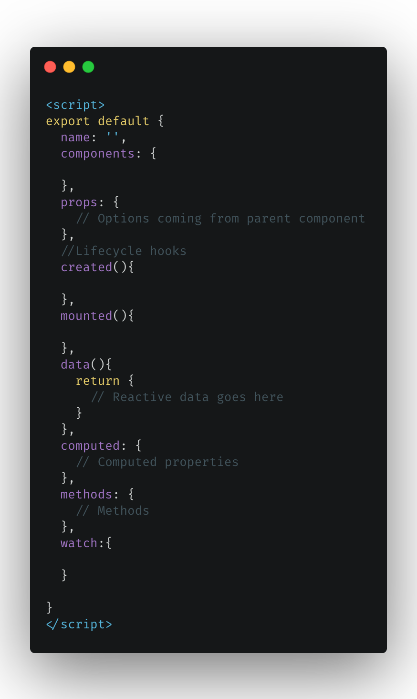
How code is organized - Script

Slide 6
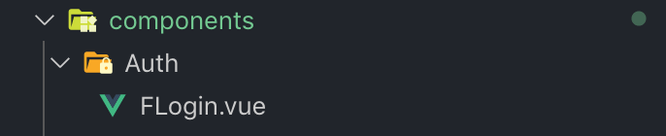
Creating a component
A component is created by creating a file with a .vue instance
You can also use jsx and render functions

Slide 7
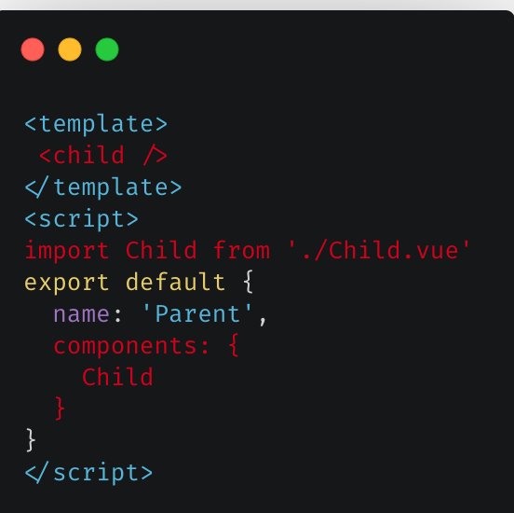
Creating a component - Importing
Simply import the component where you want to use it, and register it in the components object of your parent component.

Slide 8
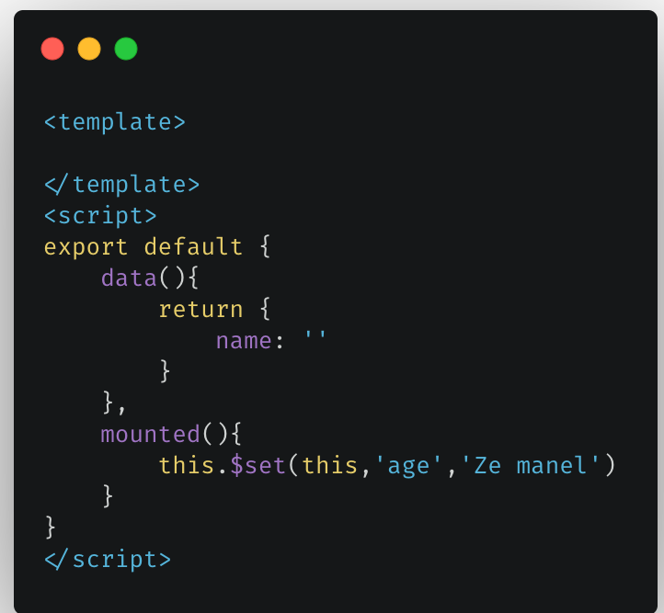
State management in Vue
Vue provides a data function, any predefined properties are created as reactive.
We can however, create explicit reactive properties with Vue.set() or Vue.observable()

Slide 9
Props - let’s communicate with child components
Props provide and easy way to pass any information down to child components;
They can provide any type of value;
They are reactive;

Slide 10
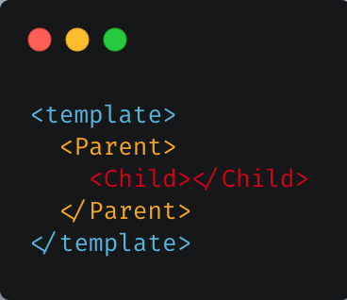
Props - Abstract
Pass data to the child component

Slide 11
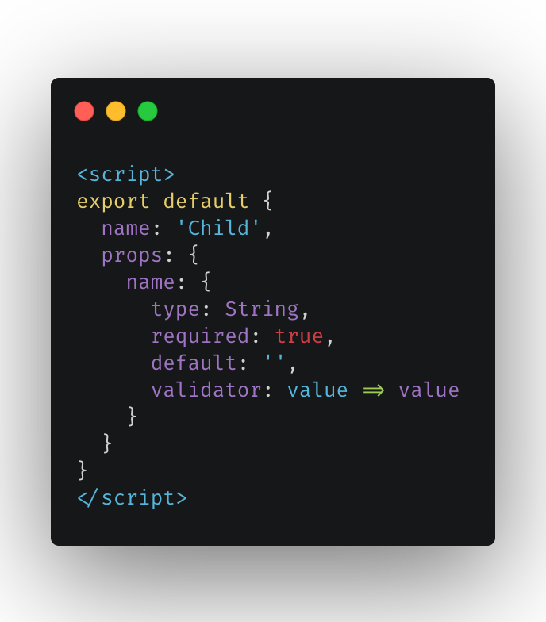
Props - Define props in child component

Slide 12
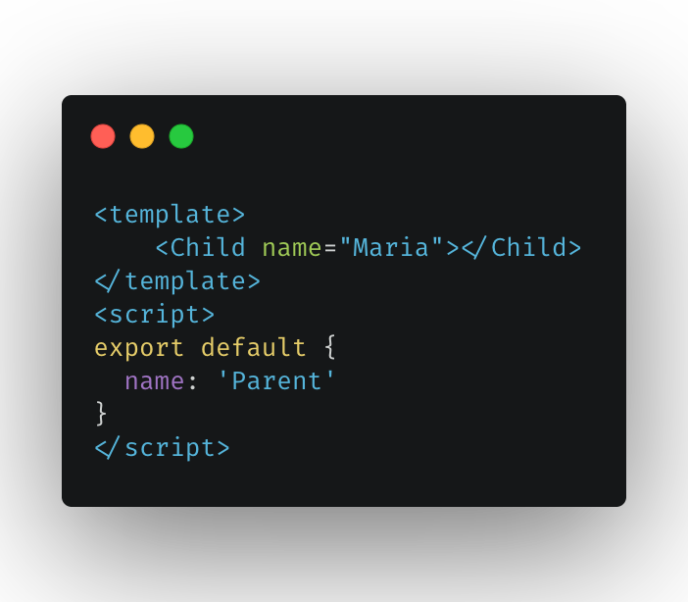
Props - Pass prop ‘name’ to child component

Slide 13
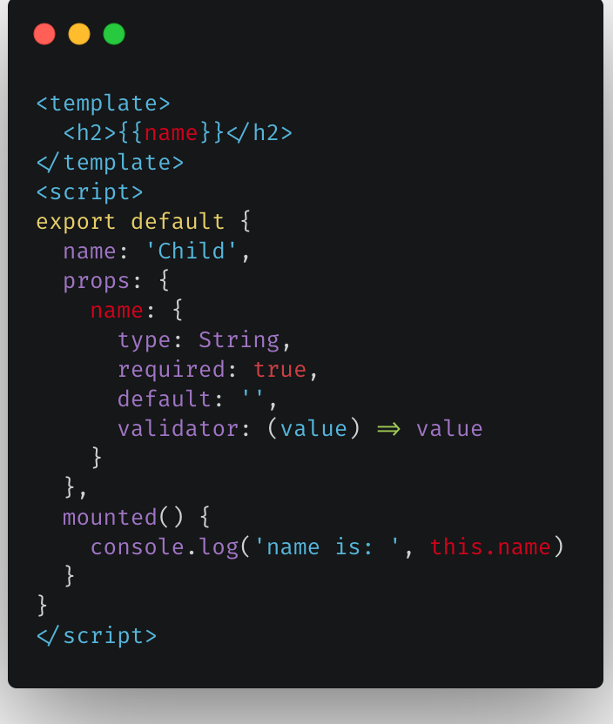
Props - Access prop value in child component
When a value is passed to a prop attribute, it becomes a property on that component instance. We can access it like any other property in the data component

Slide 14
Props - Communicate with parent
Emit events 😊
Use callbacks 😢
The sync modifier ❤️

Slide 15
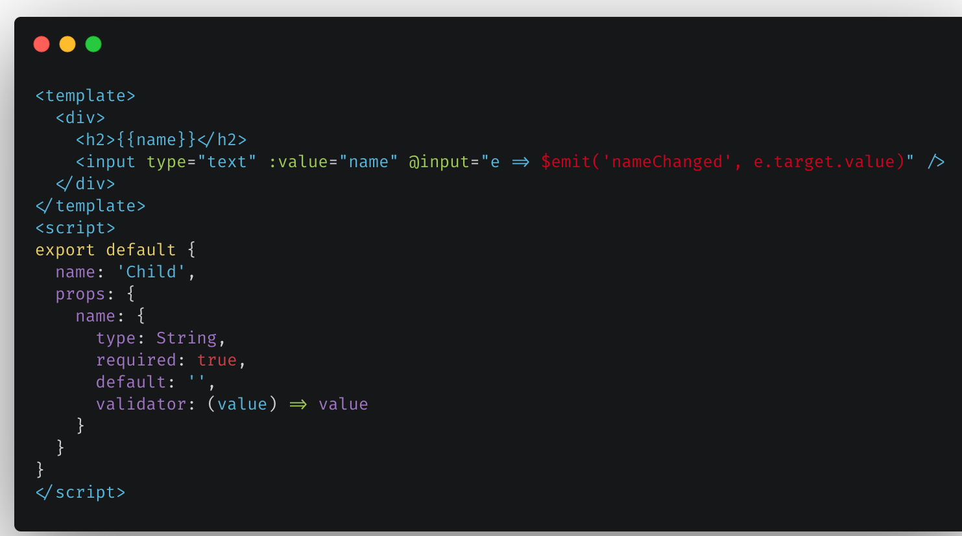
Props - Emitting event back to parent

Slide 16
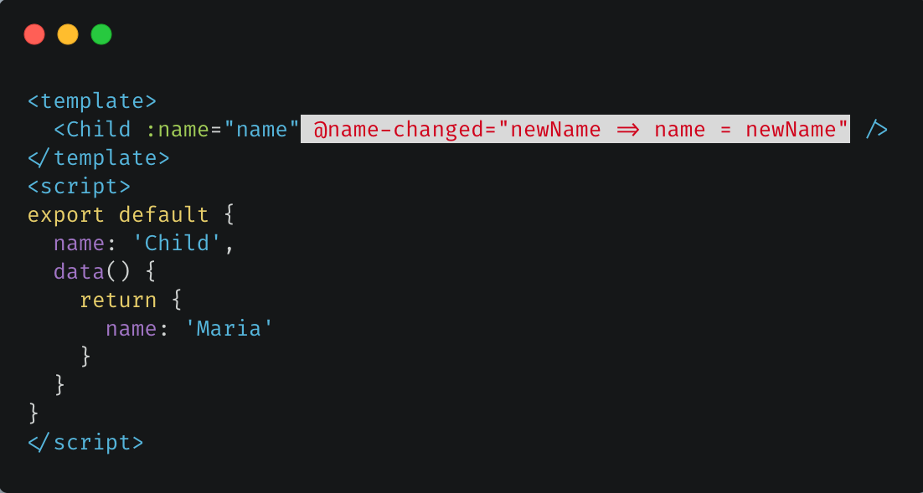
Props - listening to the event on parent

Slide 17
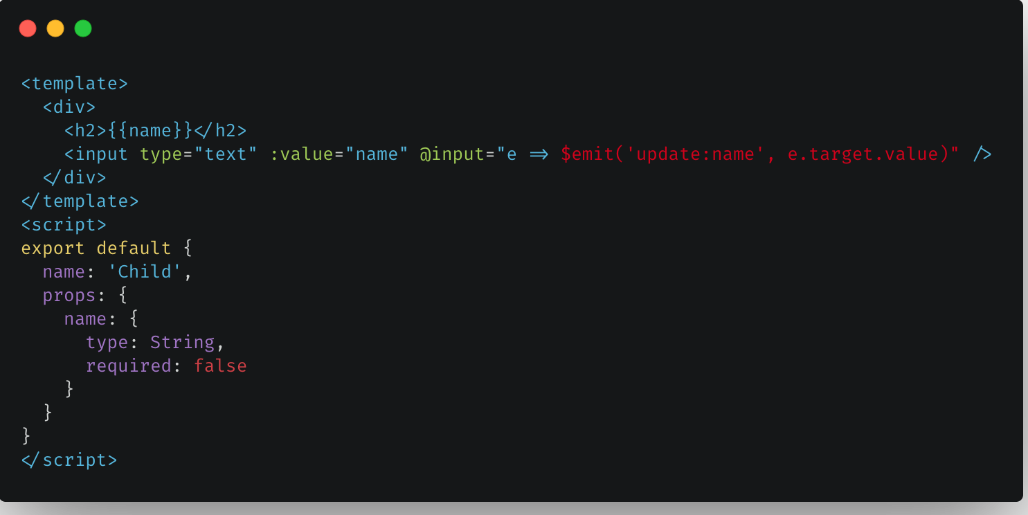
Props - sync

Slide 18
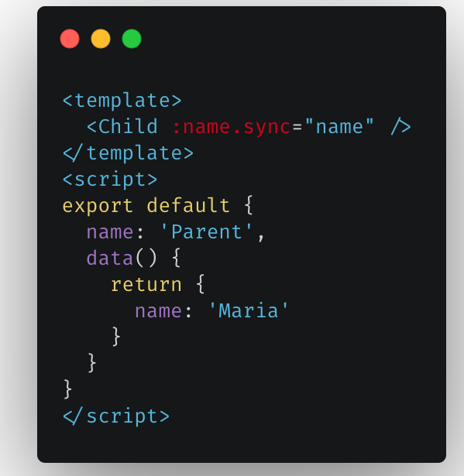
Props - sync, get changes on parent

Slide 19
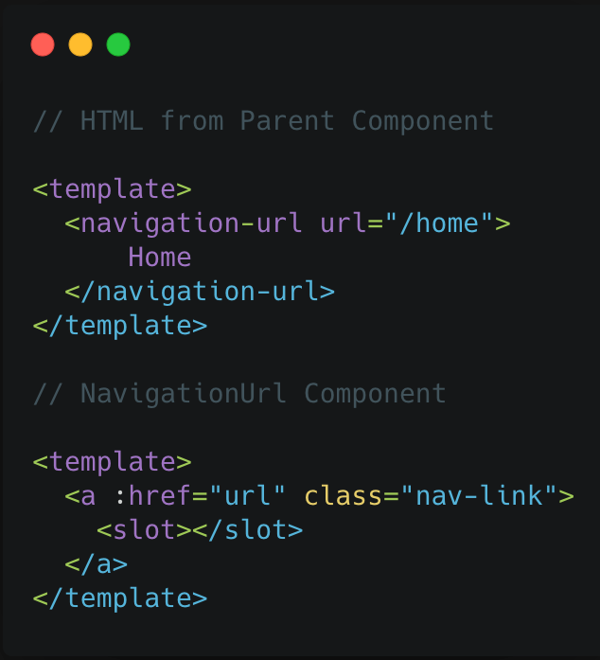
Default Slot

Slide 20
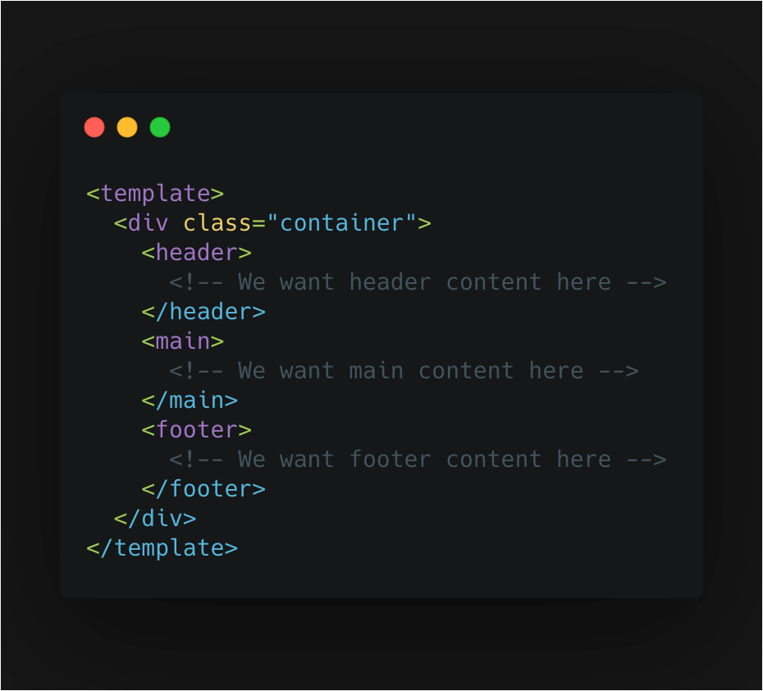
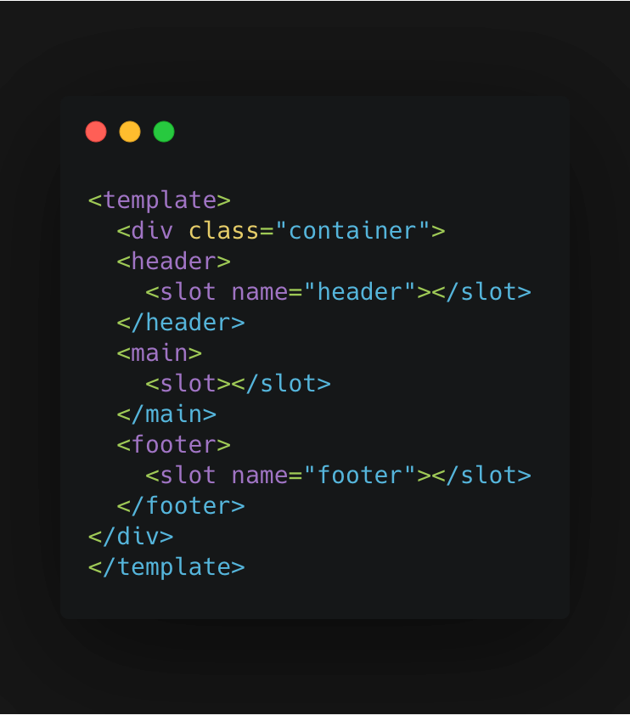
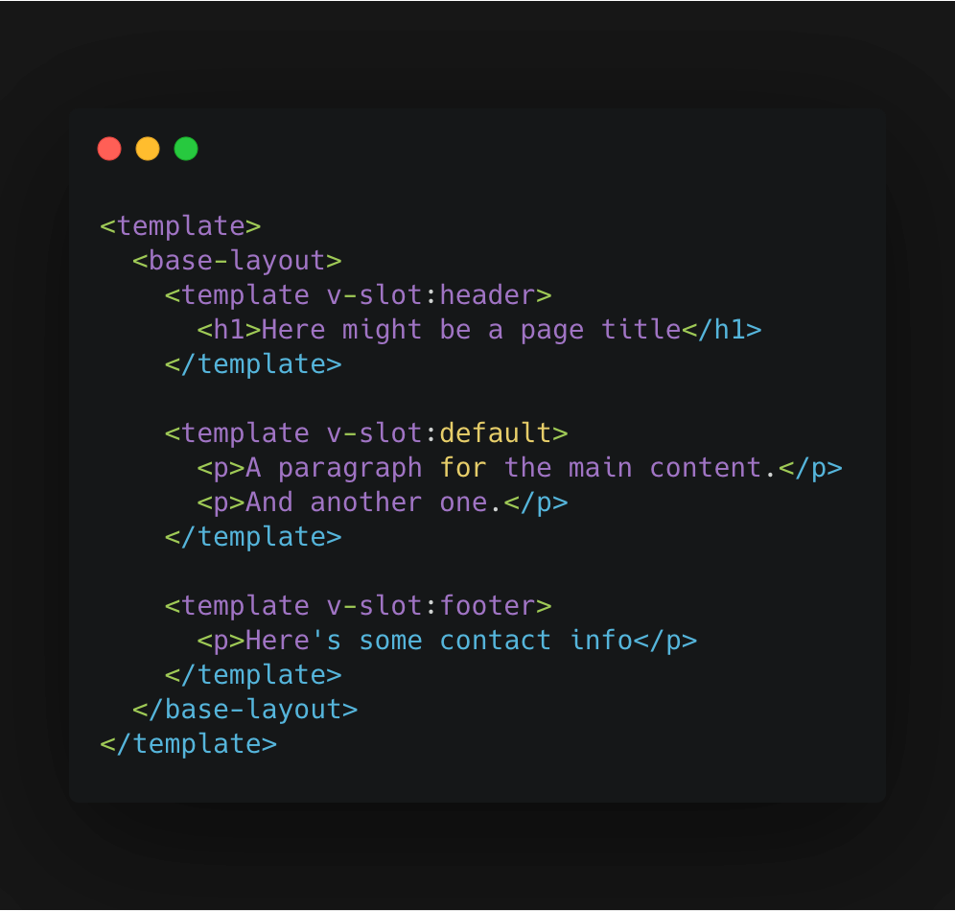
Named Slots

Slide 21
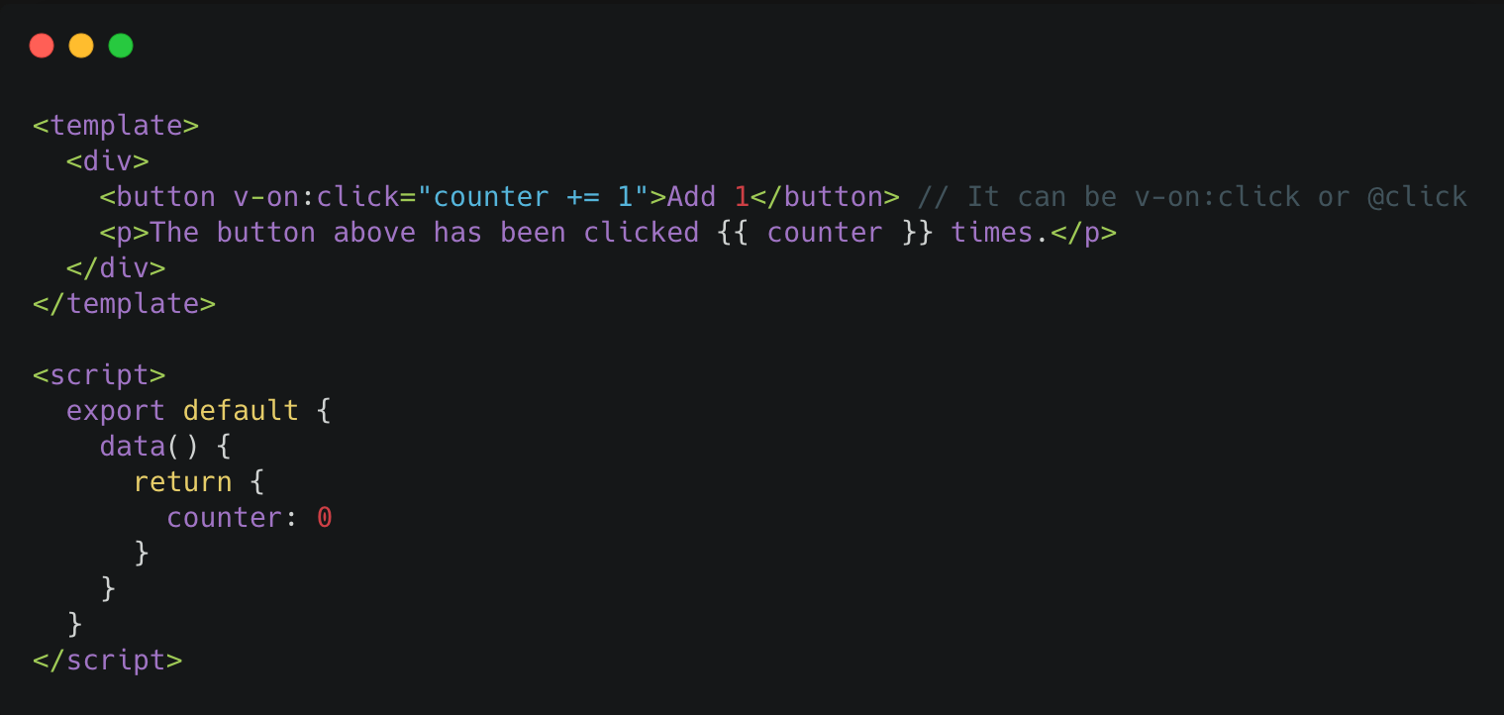
Event Handling
We can use the v-on or @ directive to listen to DOM events and run some JavaScript when they’re triggered.

Slide 22
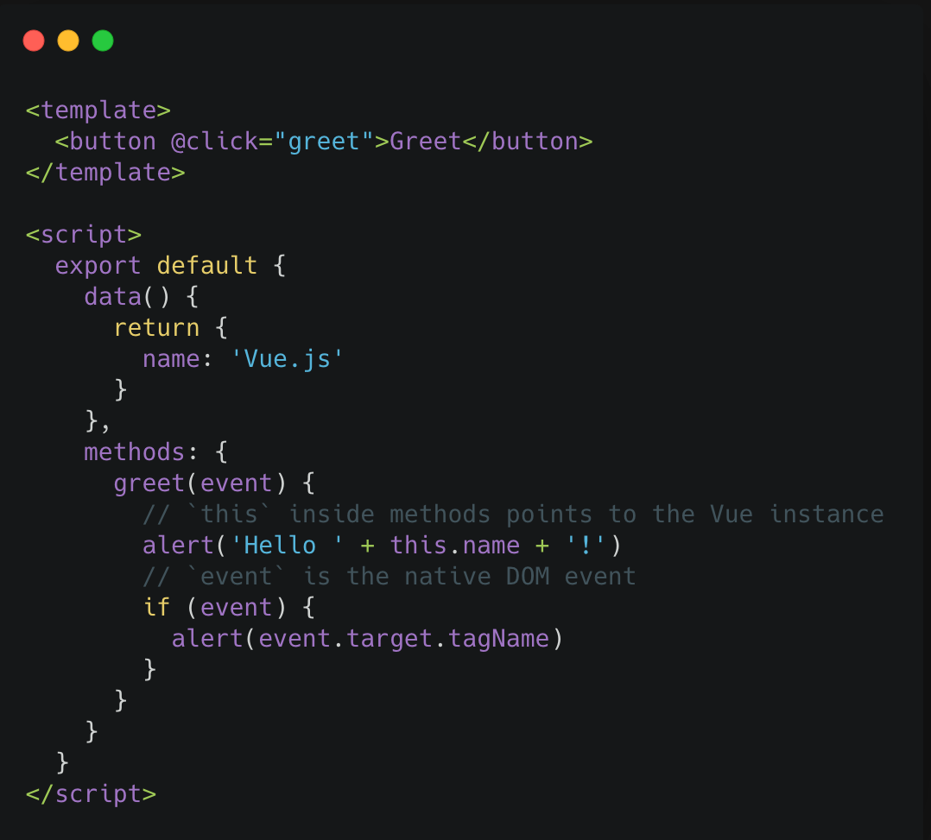
Method event handlers
The logic for many event handlers will be more complex though, so keeping your JavaScript in the value of the v-on attribute isn’t feasible. That’s why v-on can also accept the name of a method you’d like to call.

Slide 23
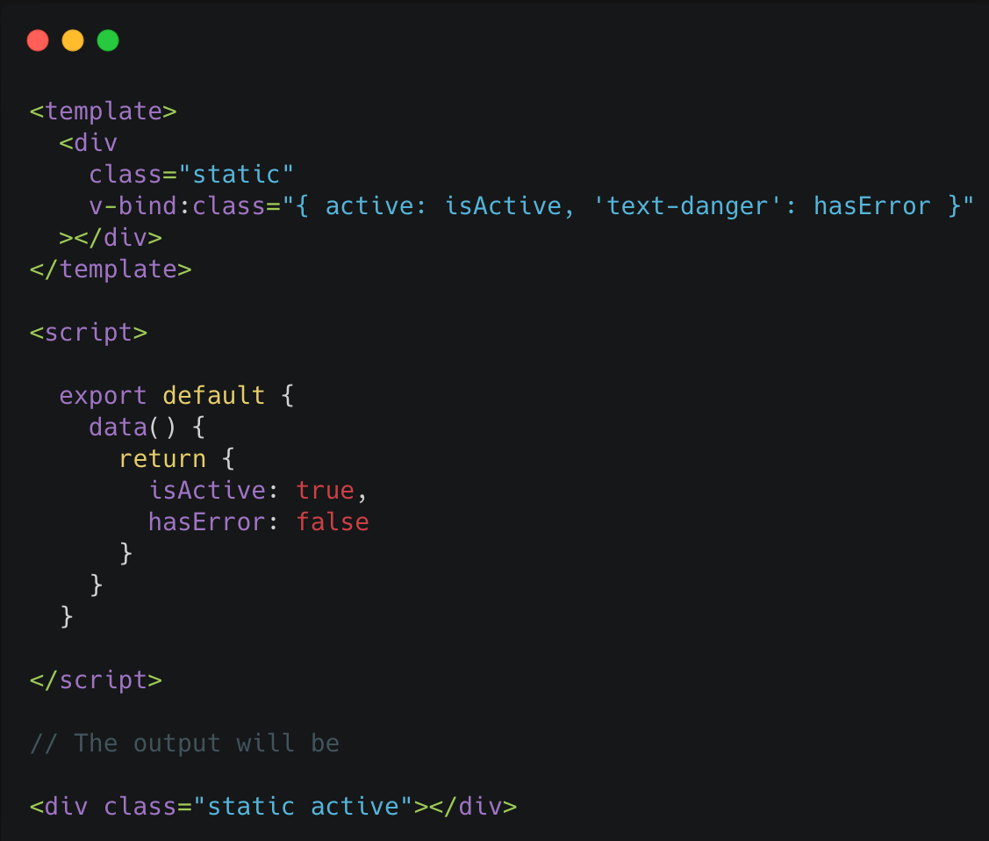
Dynamic class binding

Slide 24
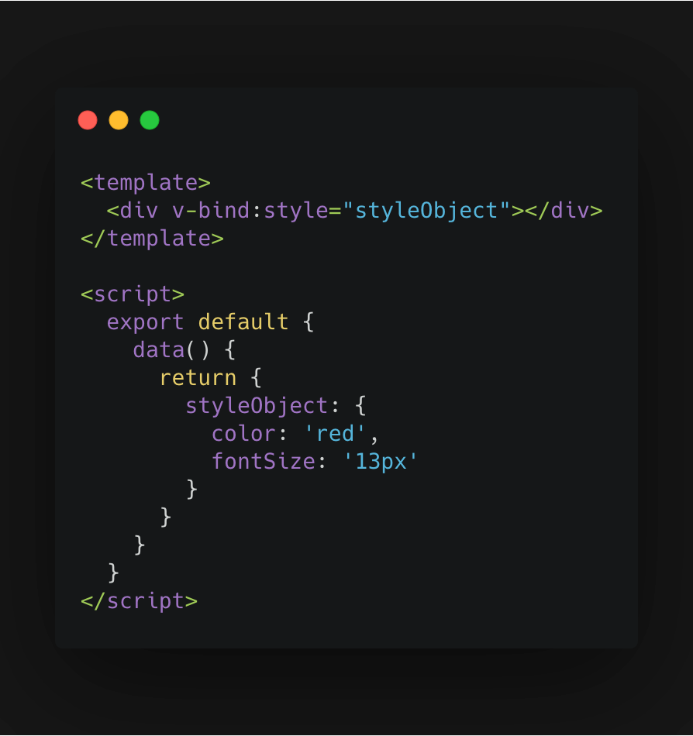
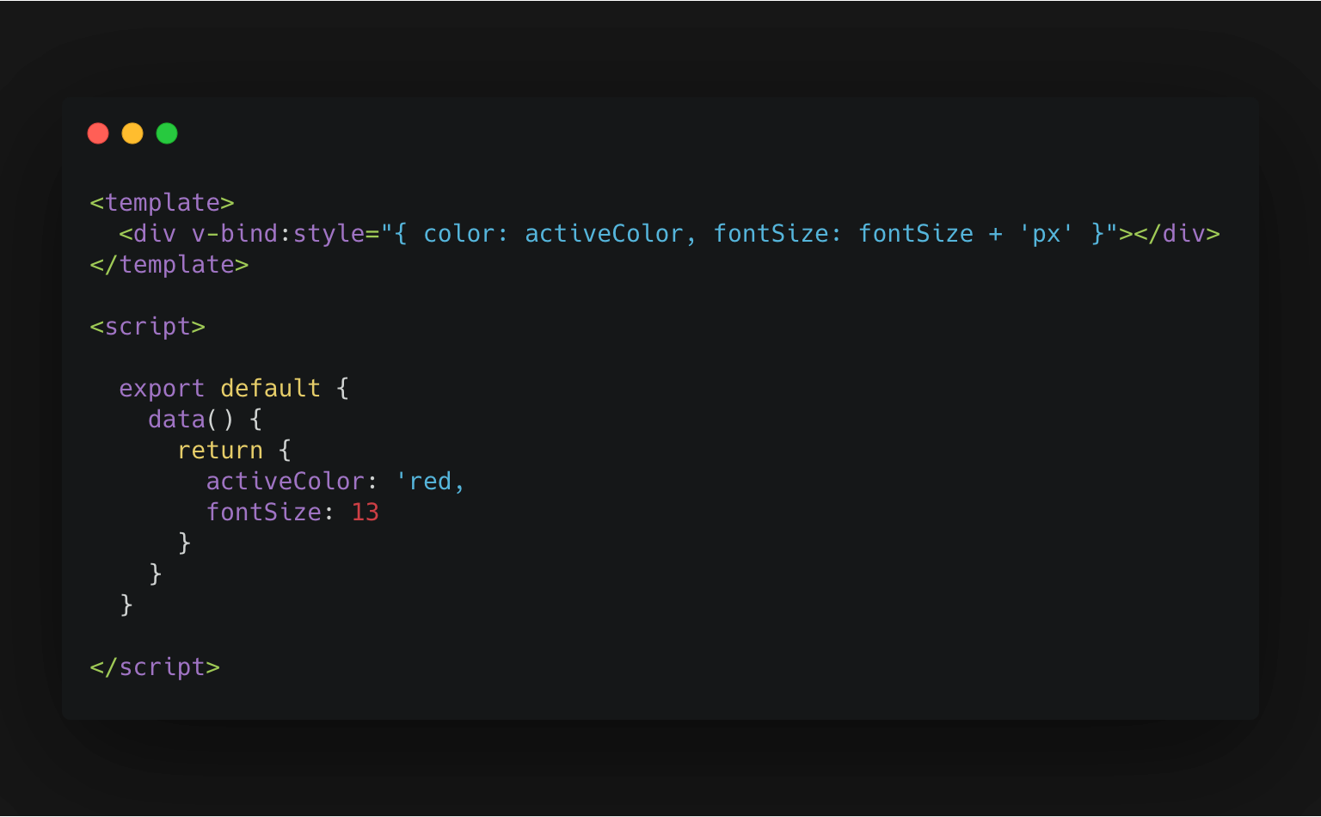
Inline Style

Slide 25
Computed Properties
Reactive properties that will re-evaluate when any of their “dependencies” (referenced properties) change
Computed properties are cached based on their reactive dependencies.
Useful when you need to extract functionality from your template and need and updated value
Note: Unlike methods you don’t execute them with (), they’re like properties and will re-evaluate automatically.

Slide 26
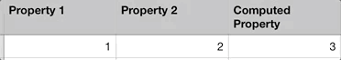
Computed Properties - Practical example
Note how the computed property re-evaluates whenever any of its dependencies change.

Slide 27
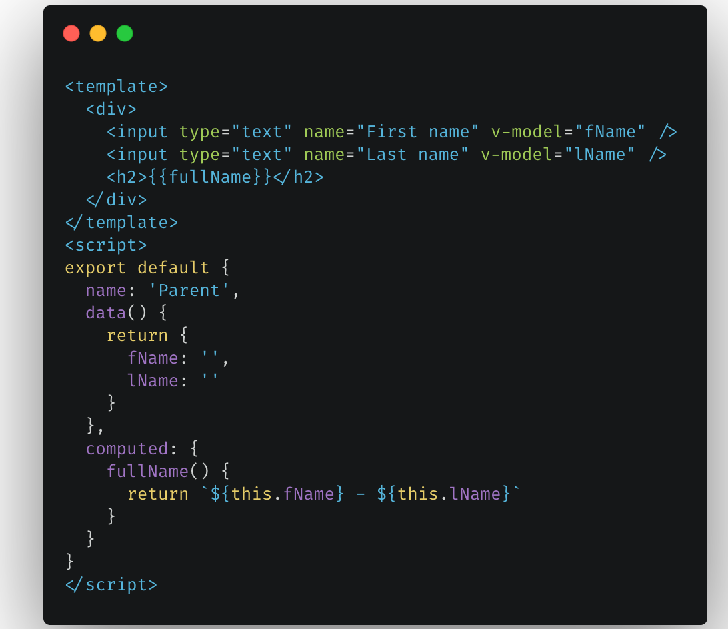
Computed Properties

Slide 28
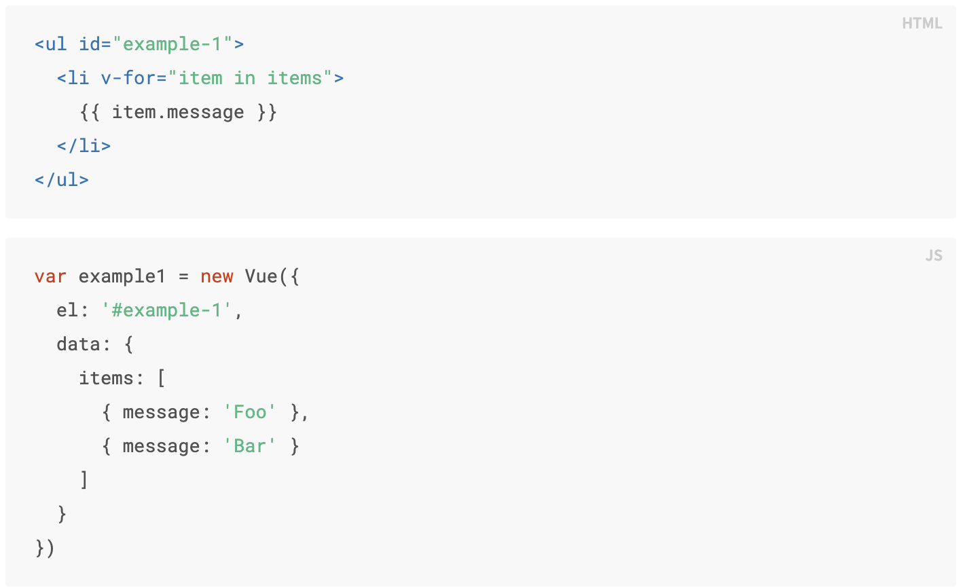
Rendering Lists

Slide 29
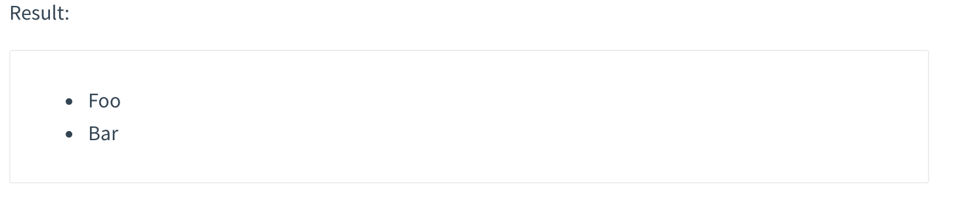
Rendering Lists - Result
Example

Slide 30
Conditional Rendering
v-if
Removes/adds the element to the DOM
v-show
toggles display: none

Slide 31
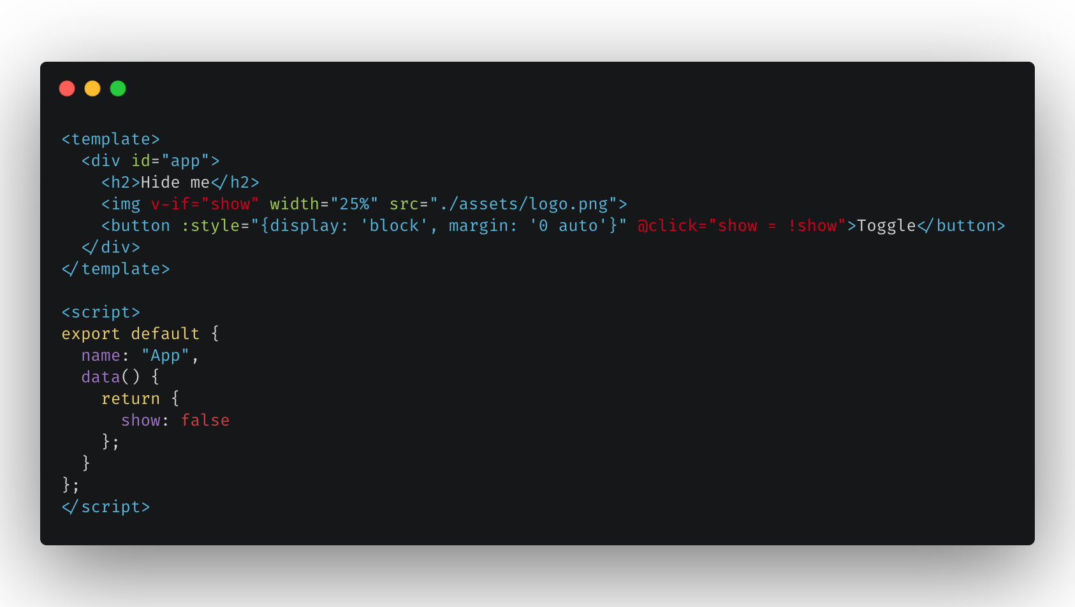
Conditional Rendering - v-if

Slide 32
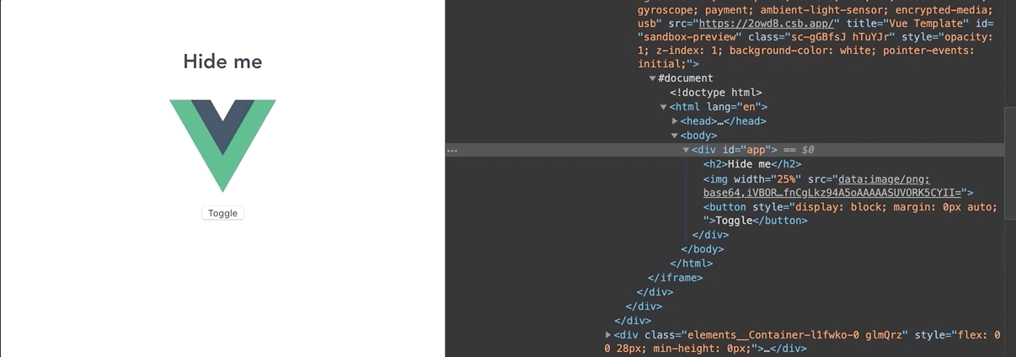
Conditional Rendering - v-if

Slide 33
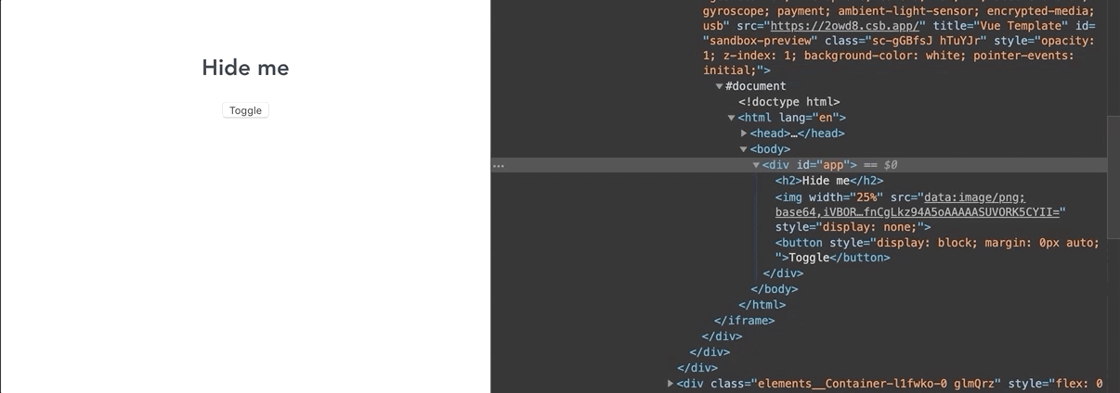
Conditional Rendering - v-show

Slide 34
ue js
Any questions?

